Slide 1
DBMS KEYS
PRIMARY, FOREIGN, SUPER AND CANDIDATE

Slide 2
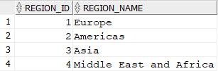
PRIMARY KEY
Primary key is a unique identifier for a particular row in a table
REGIONS TABLE

Slide 3
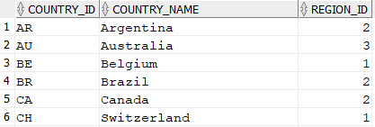
FOREIGN KEY
Foreign key is a key show the relation between the data in two table
REGIONS TABLE
COUNTRIES TABLE

Slide 4
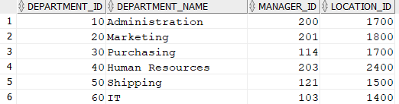
SUPER KEY AND CANDIDATE KEY
Super key is set of attributes that identify a particular row in a table
Candidate key is a minimal subset of super key
DEPARTMENTS TABLE

